Slide 1
TASK 2

Slide 2
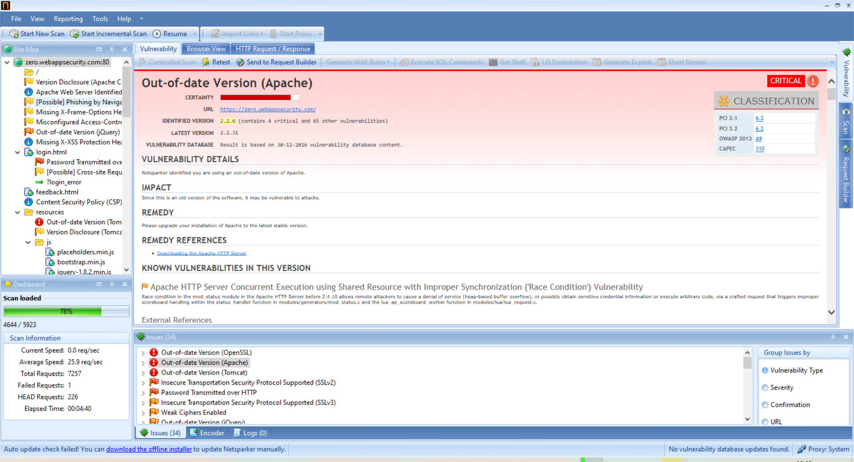
Screenshots of Generated Report:

Slide 4
Report:
Domain: https://zero.webappsecurity.com/
Hi, I just found “Out-of-date Version (Apache)” in your website
Version found: 2.2.6
Steps to find the Vulnerability.
Step 1: Open Netsparker and Add Your Website link in the dialogue box.
Step 2: Click on Start Scan.
Step 3: It will start scanning it automatically
Step 4: After some time you will be prompted with this Vulnerability.
Step 5: Click on it and you will see details about this Vulnerability.
Since it is old version of the software, it is vulnerable to attacks.
Details:
Netsparker identified out-of-date version of Apache.
Consequences of using this Version:
It can lead to Neutralization of Input during page generation
It can lead to HTTP request smuggling attacks or denial of service
It Uses ap_get_basic_auth_pw() by third-party modules outside of the authentication phase may lead to authentication requirements being bypassed
mod_mime can read one byte past the end of a buffer when sending a malicious Content-Type response header
Solution:
You can solve this issue by updating the Apache version on your website

Slide 5
3 Critical Vulnerabilities found on Website:
Out-of-date Version (OpenSSL)
Out-of-date Version (Apache)
Out-of-date Version (Tomcat)

